Slide 1
Principles of management
Chapter “1”

Slide 2
Introduction
As how the mind controls the human body and its function similar management controls the various activities in the Organization.
Management directs the collection of physical equipment's (4 M’s in Organization) Men, Machine, Materials, Money.
For efficient and profitable functioning it is necessary factors affecting the organization are put to work in a co-ordinated manner.

Slide 3
Definition
Management is the art of getting things done through others.
“ Management is the process of designing and maintaining an environment in which individuals, working together in groups efficiently to accomplish selected aims”

Slide 4
Characteristics of management
Universal
Dynamic
Group of managers
Purposeful
Goal oriented
Integrative Function
Social process
Multi-faceted discipline
Continuous process
System of authority
Intangible
Profession, an art as well as a science

Slide 5
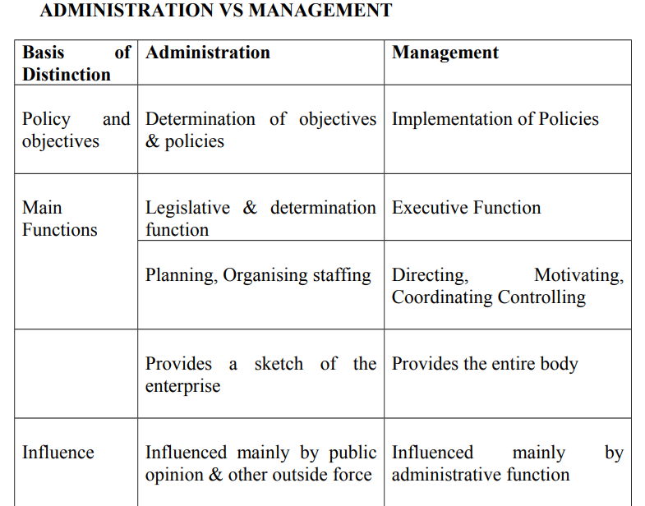
Administration vs Management

Slide 6
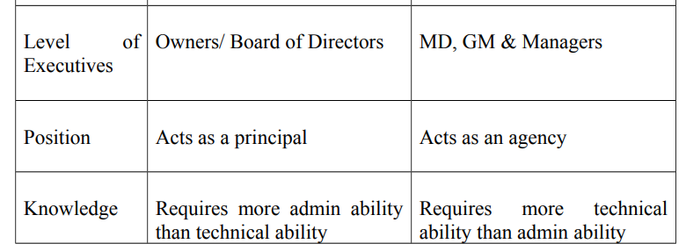
Administration vs Management

Slide 7
Applications of management
1- Management as an art
• A manager applies his knowledge and skills
to coordinate the efforts of his people.
• Management seeks to achieve concrete
practical results
• Management is creative. It brings out new
situation and converts into output
• Effective Management leads to realization of
Organizational and other goals.

Slide 8
Applications of management
2- Management as science.
Systematized body of Knowledge.
Underlying principles and theories developed through continuous observation, inquiry, experimentation and research.
Universal truth and applicability.
Organized body of knowledge can be taught and learnt in class room and outside.
Management is a social science. It contains all the essentials of science. It is an inexact science

Slide 9
Applications of management
3- Management as a Profession
The essential attribute of a profession is:
A well-defined and organized body of knowledge
Learning and Experience
Entry restricted by qualification
Recognized national body
Ethical code of conduct
Dominance of service motive

Slide 10
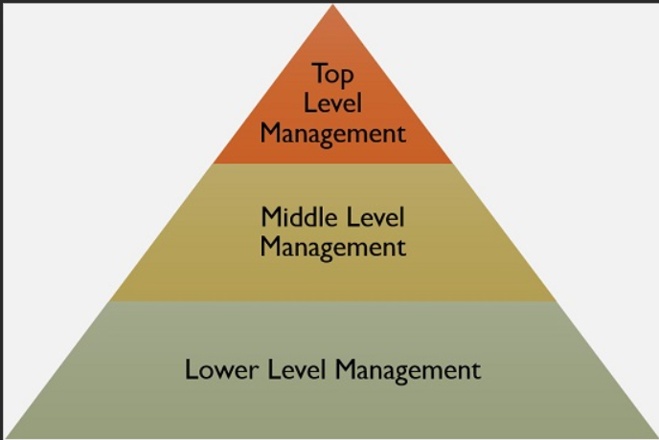
Levels of management

Slide 11
Levels of management
1- Top Level Management
(Board of Directors, Manager Director, Owners, Chief Executives)
To analyze, evaluate and deal with the environmental forces
To establish overall long term goals and broad policies of the company including the master budget
To appoint departmental and other key executives
To represent the company to the outside world
To coordinate the activities and efforts of different department

Slide 12
Levels of management
2. Middle Level Management
(Sales Executives, Production Executives, Production executives etc.)
To interpret and explain the policies framed by top management.
To compile and issue detailed instruction regarding operations.
To Cooperate among themselves so as to integrate various parts of the division or a department.
To motivate supervisory personnel to work for organization goals
To develop and train supervisory and operative personnel.

Slide 13
Levels of management
3- Lower Level Management / Supervisory / Operating
(Superintendents, Branch managers, General Foremen)
To plan day to day production within the goals lay down by higher authority .
To assign jobs to workers and to make arrangement for their training and development.
To supervise and control workers and to maintain personal contact with them.

Slide 14
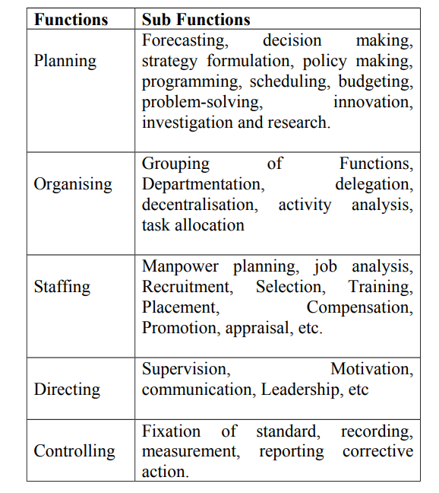
Managerial functions

